Slide 1
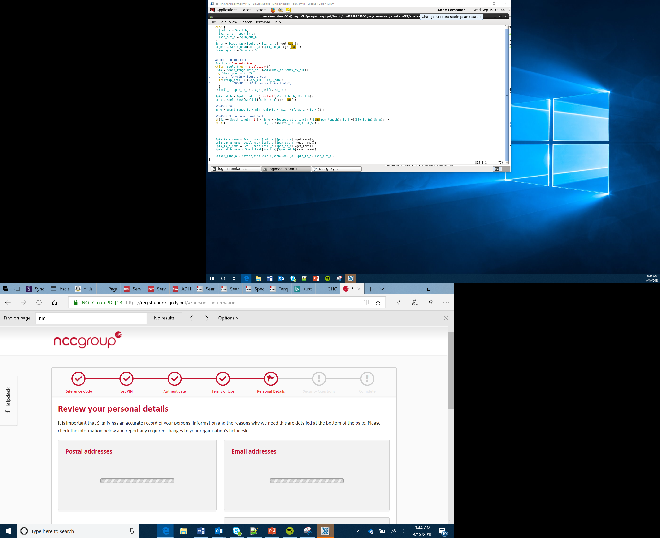

Course Introduction
Lesson 1

Slide 2
Today You Will
Understand the structure of the course
Learn how to create your own name badge using a micro:bit
Use the MakeCode website to write a computer program
Understand how to download .hex files to your micro:bit
Notes:
Today leaners will start to develop their first piece of code on the micro:bit to make a name badge. They will also learn how to transfer programs from the PC onto the micro:bit.

Slide 3
Course Overview
Learn to write your own computer programs - programming
Develop a range of physical computing solutions using a micro:bit
Throughout the course you will develop a range of products including a temperature sensor, radio communication device, rock:paper:scissors game
Work towards achieving a qualification
Notes:
The course allows leaners to start to develop their own computer systems. They will use a physical device to allow learners to actually see the result of their programming. At this stage you should just give a brief overview of some of the solutions that they will be developing throughout the course to start to generate some excitement over what they will be doing over the next few weeks. They should also be excited at the prospect of gaining a qualification.

Slide 4
Assessment Structure
You will be assessed through completing a range of practical activities as well as answering a number of short answer and multiple choice questions
At the end of each project awards will be made for various categories including:
Best teamwork
Most sophisticated programmed solution
Best designed solution
Perseverance, amongst others
The projects that you complete throughout the course are worth 20% of the overall qualification
Notes:
This should give learners an understanding of how they will be assessed throughout the course. You should stress the different categories that are available for the awards. Learners should understand that there are a lot of different categories – it isn’t just the most talented coders that will achieve awards. Learners should understand that as the ongoing projects are worth 20% of the overall mark then it is important that they complete all tasks to the best of their ability. The focus for the course is on practical activities – their understanding of the underlying theory will naturally develop as they complete the hands on tasks.

Slide 5
Assessment Objectives and Grading
Your work will be assessed against the following criteria:
Demonstrate knowledge and understanding of technology
Apply knowledge and understanding of technology
Analyse and evaluate problems
Demonstrate application of knowledge and understanding to solve problems
All learners will receive a certificate of completion at the end of the course
In addition, you will receive a grade based on the final assessment. This will be Pass, Intermediate, Higher. Anyone who does not receive the necessary mark for a Pass will receive a U
Notes:
All learners will achieve a certificate of completion which should make learners feel at ease. Go through the grading structure which is based on the final assessment but ensure that learners understand that all levels are worthwhile qualifications, not just the Higher level. It is important that Learners achieve what they are capable of and should feel proud of their achievements if they have done the best that they can.

Slide 6
The micro:bit
The micro:bit is an example of a microcontroller
It contains a number of input and output devices
The purpose of an input device is to allow data to be transferred into the computer system
The purpose of an output device is to transfer the data out of the system
Activity: using your micro:bit have a look at the different parts of the device. Can you identify any input or output devices? You should make a note of these on the worksheet
Notes:
The purpose of the activity is to give learners their first opportunity to have a look at the micro:bit. Discuss what input and output devices are, using this slide, and then allow learners to independently look over the different components on the micro:bit. After 5 minutes ask learners what they have identified. The main output that many will identify will be the LED matrix i.e. the lights which make up the screen on the front of the device. The purpose of this is to display / output the data to the user. Some may identify that the USB socket acts as an output as it can be used to transfer data from the micro:bit to a computer. On the reverse of the micro:bit the Bluetooth antenna is labelled. This also allows data to be transferred from the miro:bit wirelessly. The main input devices which learners will identify will be Buttons A and B. The Bluetooth antenna and USB socket can also act as input devices. Highlight to learners the lines or wires that appear on the reverse of the micro:bit. These wires transmit the data between the different component parts. If there is time you could also highlight the compass and accelerometer. The compass will be used in a future lesson. The accelerometer allows gestures to be detected such as whether someone is shaking the micro:bit. This also acts as an input device.

Slide 7
The micro:bit
Input devices – allow data to be transferred into the micro:bit
Output devices – show the result of the data having been processed
An LED screen is an example of an output device
Notes:
This initial introduction reminds learners of the concept of input and output devices. You could use questioning prior to showing the slide to see if any learners are able to recall the material covered in the last lesson.

Slide 8
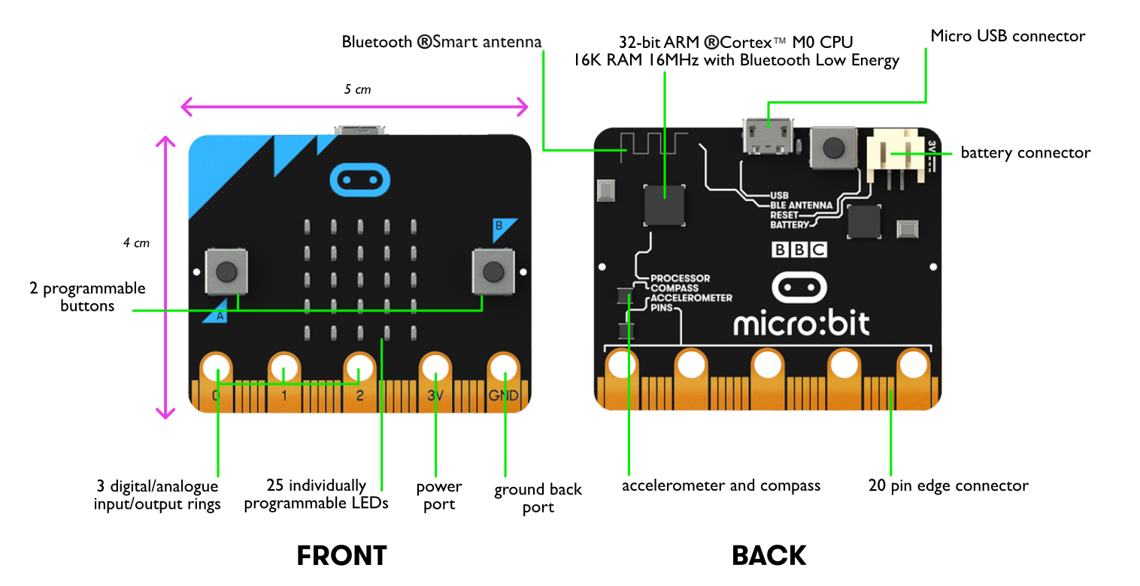
The micro:bit in Detail
Notes:
This builds on the concept of input and output devices. Use the labels to highlight the different components on the micro:bit. The ARM processor acts as the brain of the computer. It processes all instructions from the other components on the device. The accelerometer and compass (magnetometer) are able to automatically detect things and use those readings to input data into the device – these are called sensors. Sensors will be used in future lessons. At this stage it is useful that learners understand that they can be used to generate automatic inputs.

Slide 9
Name Badge Task
You are going to create your own name badge using the micro:bit
Use the instructions to guide you through the task
Once you have created your name badge attempt to complete the Stretch Tasks
Good luck!
Notes:
Learners should then start to program their own name badge. This is the first time that learners will have used the micro:bit in the lesson and they are certain to enjoy the task. The most challenging part of the task will be transferring the hex file from the PC onto the micro:bit. This should initially be demonstrated by the Teacher. It is also worth stressing that all of the blocks are colour coded, which should help learners to find where they are located.
How to Ensure that MakeCode is available
Ensure the following website are unfiltered (a constantly updated list is available at https://support.microbit.org/support/solutions/articles/19000030385-firewall-whitelist-requirements-for-micro-bit-editors)
You need access to USB devices if these are blocked by default all Micro:bits use the same ID – use your security policy to exempt the micro:bit ID
PXT / MakeCode/Javascript Blocks Editor:
pxt.microbit.org
makecode.microbit.org
makecode.com www.pxt.io trg-microbit.userpxt.io pxt.azureedge.net
github.com Blocks:
www.microbit.co.uk
Touch Develop:
www.microbit.co.uk
Code Kingdoms:
www.microbit.co.uk
microbit.codekingdoms.com
Python Web Editor (microbit.co.uk)
www.microbit.co.uk
Python Web Editor (microbit.org)
python.microbit.org

